Slide 1


CS-429 Introduction to Data Science
Singular Value Decomposition (SVD) and
Principal Component Analysis (PCA)
Mubashir Iqbal
Lecturer in Computer Science Department
HITEC University Taxila

Slide 2
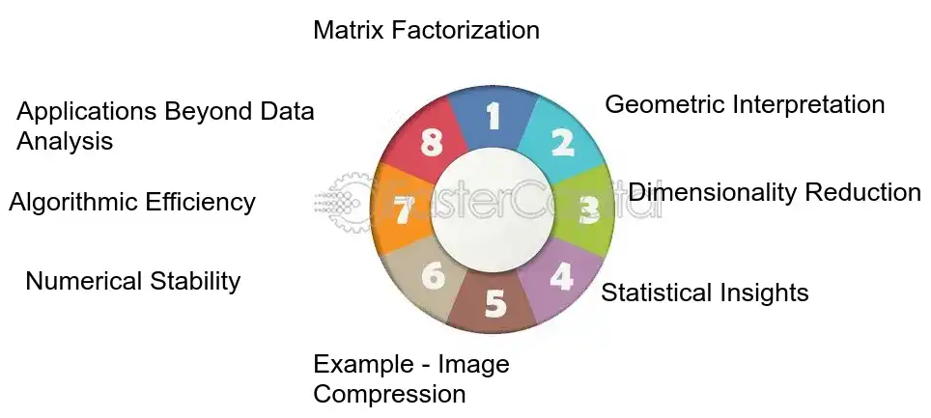
Singular Value Decomposition (SVD)

Slide 3
What is a Singular Value Decomposition (SVD) ?
Singular Value Decomposition is a mathematical technique used in linear algebra.
SVD is a matrix factorization algorithm representing a matrix as a series of linear approximations. It’s similar to principal component analysis (PCA), but SVD is more general and doesn’t assume the input is a square matrix.
SVD helps us understand and process complex data by reducing its dimensions.
It is widely used in machine learning, data compression, and recommendation systems.

Slide 4
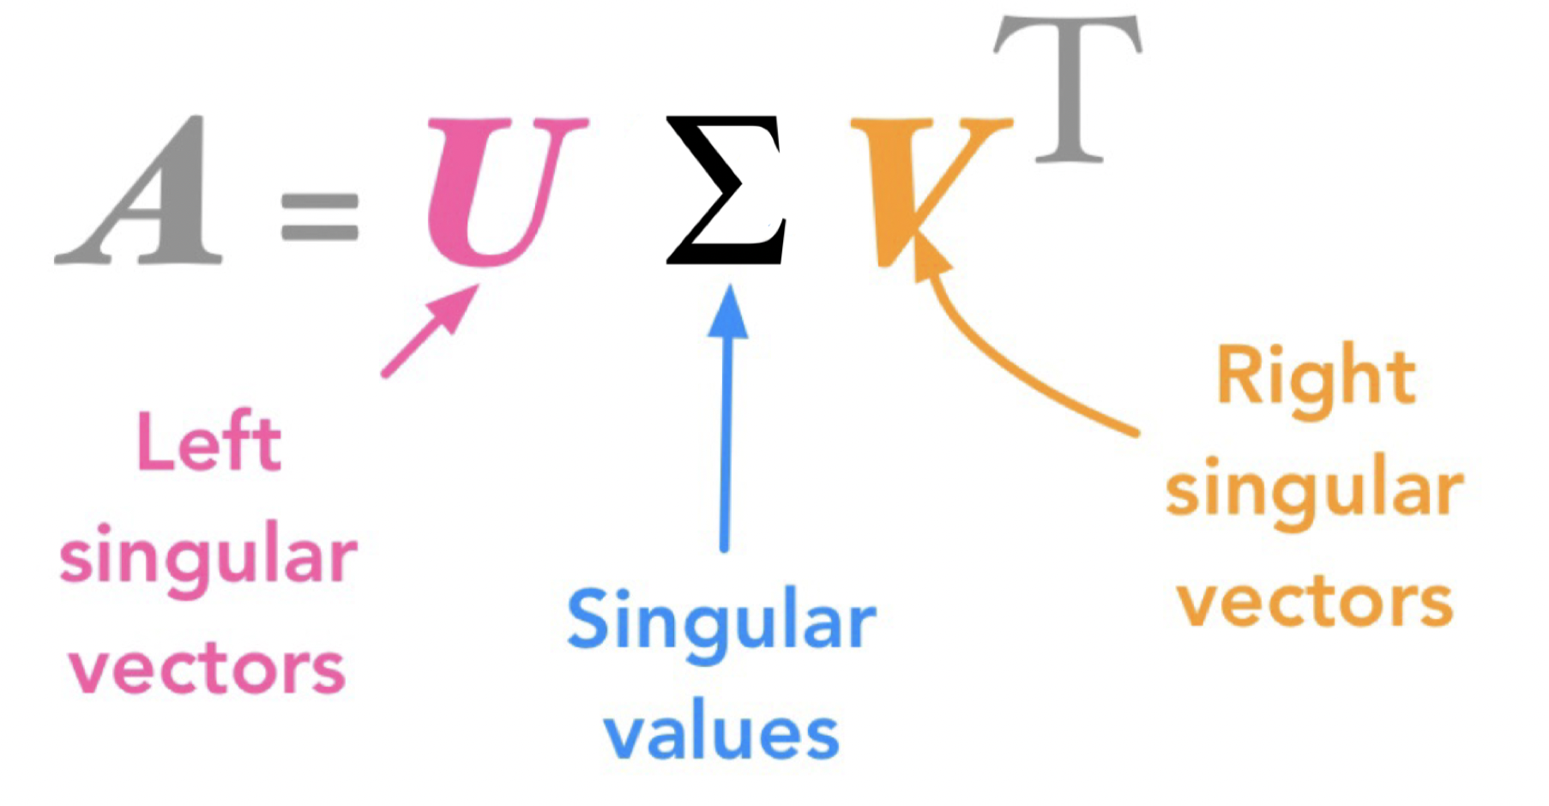
What is the SVD?
In simple words, it is the method to decompose a matrix into three matrices.
The SVD of an m*n matrix A with real values is a factorization of A as U∑V^T, where U is an m*m orthogonal matrix, V is an n*n orthogonal matrix, and ∑ is a diagonal matrix with nonnegative real entries on the diagonal.

Slide 5
What is the SVD?
In simple words, it is the method to decompose a matrix into three matrices.
The SVD of an m*n matrix A with real values is a factorization of A as U∑V^T, where U is an m*m orthogonal matrix, V is an n*n orthogonal matrix, and ∑ is a diagonal matrix with nonnegative real entries on the diagonal.

Slide 6
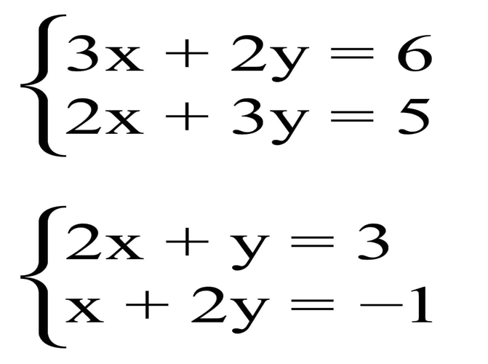
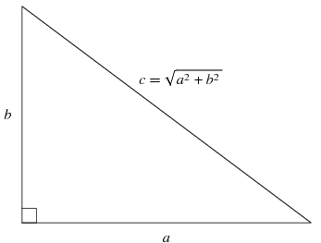
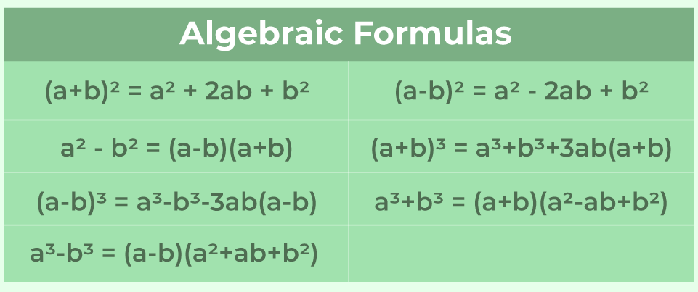
Not included in the Syllabus
Algebra?
If you don’t know the algebra
Pythagorean Theorem

Slide 7
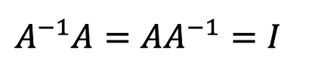
What is the orthogonal matrix ?
An orthogonal matrix is a square matrix where the transpose of the Square Matrix is also the inverse of Square Matrix.
That also mean

Slide 8
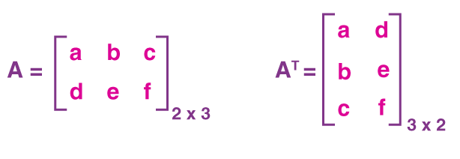
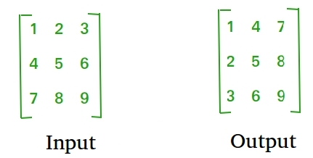
What is the Transpose of a matrix?
Transpose of a matrix is obtained by changing rows to columns or columns to rows.

Slide 9
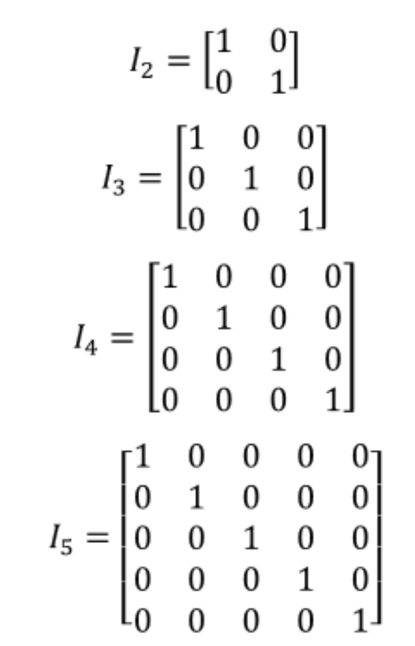
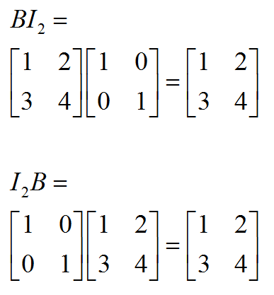
What is the Identity matrix ?
An identity matrix is a square matrix where:
All the diagonal elements are 1
All off-diagonal elements are 0
When any square matrix is multiplied by the identity matrix, the original matrix remains unchanged.
i.
ii.

Slide 10

Finding the Inverse of a 3x3 Matrix
To find the inverse of a 3x3 square matrix 𝐴:
Check Determinant:
If det(𝐴)=0, the matrix is not invertible.
Find the Cofactor Matrix:
Compute the determinant of each 2x2 minor of A
Assign signs (+/-) based on the position in the matrix.
Find the Adjoint:
Transpose of the cofactor matrix.
Compute the Inverse:
$$A^{−1}=\frac{1}{det\left(A\right)}.adj\left(A\right)=\frac{adj\left(A\right)}{det\left(A\right)}$$

Slide 11
Finding the Inverse of a 3x3 Matrix
Square matrix 𝐴:
Check Determinant: If det(𝐴)=0, the matrix is not invertible.

Slide 12
Finding the Inverse of a 3x3 Matrix
Square matrix 𝐴:
Find the Cofactor Matrix:

Slide 13
Finding the Inverse of a 3x3 Matrix
Square matrix 𝐴:
Find the Cofactor Matrix:
Assign signs (+/-) based on the position in the matrix.

Slide 14
Finding the Inverse of a 3x3 Matrix
Square matrix 𝐴:
Find the Cofactor Matrix:
Find the Adjoint: Transpose of the cofactor matrix.

Slide 15
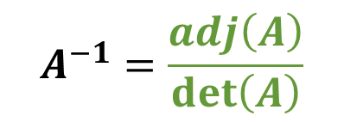
Finding the Inverse of a 3x3 Matrix
Square matrix 𝐴:
det(𝐴) Transpose(𝐴)
Compute the Inverse:
$$A^{−1}=\frac{adj\left(A\right)}{det\left(A\right)}$$
Compute and Verify this

Slide 16
What is the Eigenvalues and Eigenvectors?
Eigenvectors: Special vectors that only change in scale (not direction) when a matrix is applied to them.
Eigenvalues: The amount by which the eigenvector is scaled when the matrix is applied.
Mathematical Definition:
For a square matrix 𝐴, an eigenvector 𝑣 and eigenvalue 𝜆 satisfy this equation:

Slide 17
Finding the Eigenvalues and Eigenvectors?
Solve the characteristic equation:
This gives the eigenvalues (𝜆).
Substitute each eigenvalue into to find the eigenvector 𝑣.

Slide 18
No need to understand the inner mathematics
In simple words, it is the method to decompose a matrix into three matrices.
The SVD of an m*n matrix A with real values is a factorization of A as U∑V^T, where U is an m*m orthogonal matrix, V is an n*n orthogonal matrix, and ∑ is a diagonal matrix with nonnegative real entries on the diagonal.

Slide 19
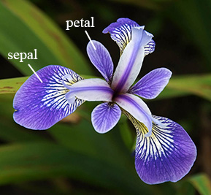
Applying SVD on Iris dataset
The Iris dataset was introduced by Ronald Fisher in 1936.
Dataset contains 150 records/samples.
The dataset is used to classify different species of the Iris flower based on their physical measurements.
Features:
Sepal length (in cm)
Sepal width (in cm)
Petal length (in cm)
Petal width (in cm)

Slide 20
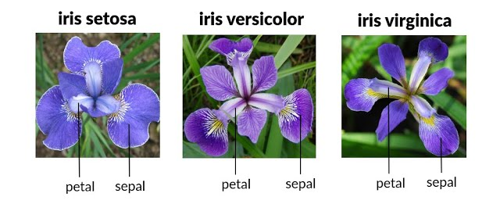
Example (Iris Dataset)
Target Variable: The species of the flower, which can be one of three classes:
Iris Setosa (0)
Iris Versicolor (1)
Iris Virginica (2)

Slide 21
Example (Iris Dataset)
sepal.length | sepal.width | petal.length | petal.width | variety
5.1 | 3.5 | 1.4 | 0.2 | Setosa
4.9 | 3 | 1.4 | 0.2 | Setosa
4.7 | 3.2 | 1.3 | 0.2 | Setosa
4.6 | 3.1 | 1.5 | 0.2 | Setosa
7 | 3.2 | 4.7 | 1.4 | Versicolor
6.4 | 3.2 | 4.5 | 1.5 | Versicolor
6.9 | 3.1 | 4.9 | 1.5 | Versicolor
6.5 | 3 | 5.8 | 2.2 | Virginica
7.6 | 3 | 6.6 | 2.1 | Virginica
4.9 | 2.5 | 4.5 | 1.7 | Virginica

Slide 22
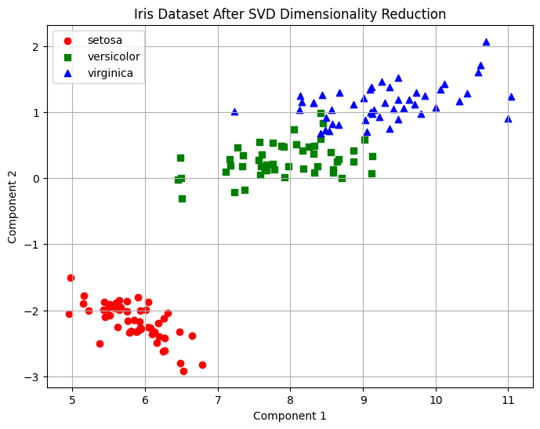
Applying SVD on Iris dataset
# Step 1: Load the Iris dataset
iris = load_iris()
data = iris.data # Features
target = iris.target # Labels
feature_names = iris.feature_names
# Step 2: Apply SVD
# Using TruncatedSVD to reduce to 2 components
svd = TruncatedSVD(n_components=2, random_state=42)
data_reduced = svd.fit_transform(data)
# Step 3: Visualize the reduced data
plt.figure(figsize=(8, 6))
for label, color, marker in zip(range(3), ['r', 'g', 'b'], ['o', 's', '^']):
plt.scatter(
data_reduced[target == label, 0],
data_reduced[target == label, 1],
color=color,
marker=marker,
label=iris.target_names[label]
)
plt.title('Iris Dataset After SVD Dimensionality Reduction')
plt.xlabel('Component 1')
plt.ylabel('Component 2')
plt.legend()
plt.grid(True)
plt.show()
GitHub Link

Slide 23
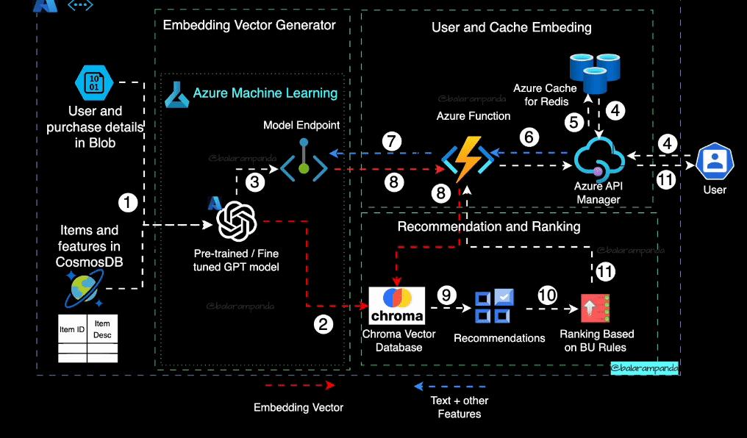
Applications of SVD
1. Recommender Systems:
Use Case: Collaborative filtering for product recommendations.
Example: Netflix or Amazon recommending movies/products based on user-item matrices.
How SVD Helps: Decomposes the user-item rating matrix into underlying factors. Captures relationships between users and items for personalized recommendations.
Dataset: MovieLens Dataset

Slide 24
Applications of SVD
2. Text Analysis and Natural Language Processing:
Use Case: Latent Semantic Analysis (LSA) for topic modeling.
Example: Identifying hidden topics in documents or summarizing large datasets.
How SVD Helps:
Decomposes the term-document matrix to extract latent topics.
Dataset: 20 Newsgroups Dataset

Slide 25

Applications of SVD
3. Image Compression:
Use Case: Reduce the storage size of images while preserving essential features.
Example: Compressing JPEG images for faster transmission over networks.
How SVD Helps: Retains the most significant singular values to reconstruct the image with minimal loss.
Dataset: Any high-resolution image dataset like CIFAR-10.

Slide 26
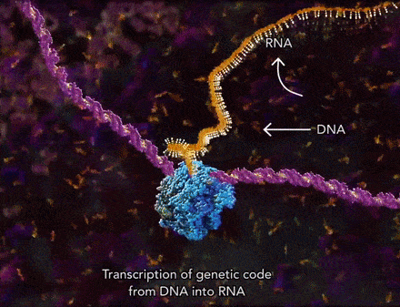
Applications of SVD
4. Genomics:
Use Case: Analyze gene expression data.
Example: Finding patterns in DNA microarray data.
How SVD Helps:
Identifies hidden structures in large, noisy datasets.
Dataset: Gene Expression Omnibus

Slide 27
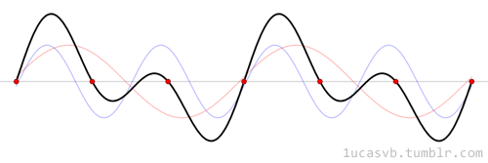
Applications of SVD
5. Signal Processing:
Use Case: Noise reduction in audio signals.
Example: Denoising audio recordings or ECG signals.
How SVD Helps:
Filters noise by discarding small singular values.
Dataset: Any signal dataset like MIT-BIH Arrhythmia Database

Slide 28
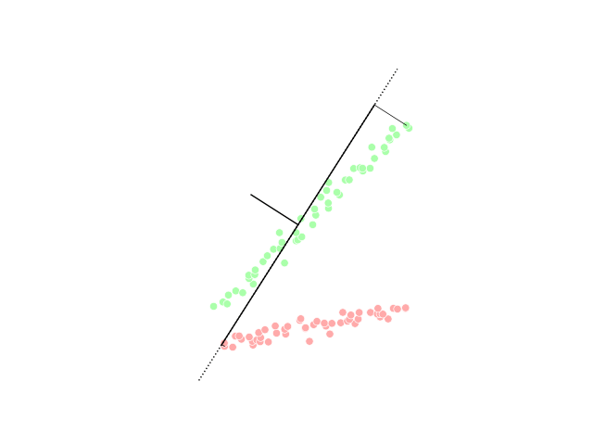
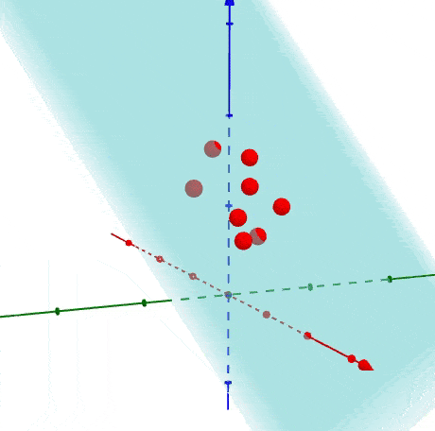
Principal Component Analysis (PCA)

Slide 29
What is PCA Algorithm?
Principal Component Analysis (PCA) is a dimensionality reduction algorithm used in artificial intelligence to simplify high-dimensional datasets while retaining the most critical information.
It transforms the original features into new, uncorrelated variables called principal components.
Purpose: Reduce data complexity while minimizing information loss.
Key Idea: Identify directions (principal components) where the data varies the most and project the data onto those directions.

Slide 30
Components of PCA
1. Original Features:
The input dataset, where each feature represents a dimension.
2. Covariance Matrix:
Represents the variance and relationships between features.
3. Principal Components:
New axes in the feature space that maximize variance and are orthogonal (uncorrelated).
The first principal component captures the most variance, followed by the second, and so on.

Slide 31
Components of PCA
4. Eigenvalues and Eigenvectors :
Measure the amount of variance captured by each principal component.
Larger eigenvalues indicate more significant components.
Directions (unit vectors) corresponding to eigenvalues that define the principal components.

Slide 32
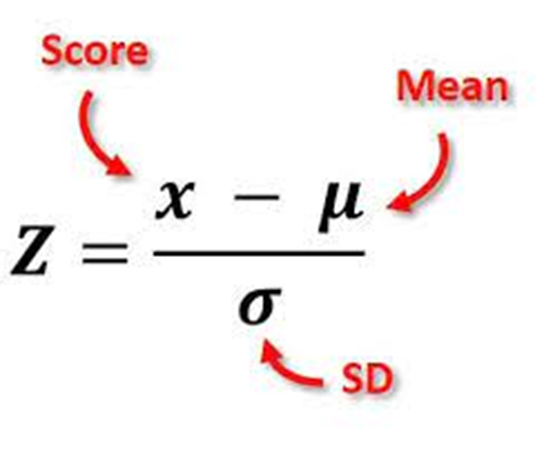
Steps in PCA
Standardize the Data:
Center the data by subtracting the mean and scale features for unit variance.
Where 𝑋 is the data, 𝜇 is the mean, and 𝜎 is the standard deviation.
Compute the Covariance Matrix:
Measure how features vary with respect to each other.
Z-Score in Normal data distribution

Slide 33
Steps in PCA
Compute Eigenvalues and Eigenvectors:
Solve the eigenvalue equation:
Where 𝜆 are eigenvalues, and 𝑣 are eigenvectors.
Select Top Principal Components:
Choose the components with the highest eigenvalues to reduce dimensionality.
Transform the Data:
Project the original data onto the principal components:
Where 𝑌 is the transformed data, and 𝑉 contains the selected eigenvectors.

Slide 34
Wine Dataset
The Wine Dataset is a popular UCI Machine Learning Repository dataset and is also included in scikit-learn. It is often used for classification and dimensionality reduction tasks. Below are the details:
Purpose: Classify wines based on their chemical analysis.
Number of Instances (Samples): 178.
Number of Features: 13 numerical features.
Number of Classes (Targets): 3 (Wine cultivars or types)..
from sklearn.datasets import load_wine
data = load_wine()
X = data.data # Features
y = data.target # Target labels
feature_names = data.feature_names

Slide 35
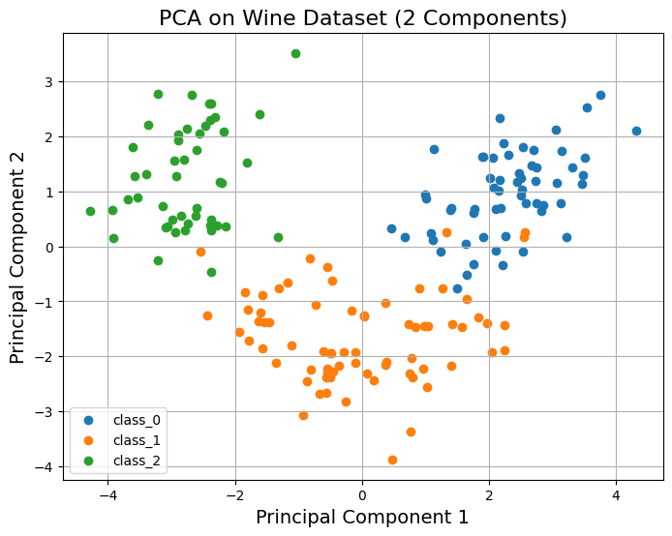
Applying PCA on Wine dataset
data = load_wine()
X = data.data # Features
y = data.target # Target labels
feature_names = data.feature_names
scaler = StandardScaler()
X_scaled = scaler.fit_transform(X)
# Apply PCA to reduce dimensions to 2 components
pca = PCA(n_components=2)
X_pca = pca.fit_transform(X_scaled)
# Create a DataFrame for the PCA results
pca_df = pd.DataFrame(data=X_pca, columns=['Principal Component 1', 'Principal Component 2'])
pca_df['Target'] = y
# Visualize the PCA results
plt.figure(figsize=(8, 6))
for target in np.unique(y):
subset = pca_df[pca_df['Target'] == target]
plt.scatter(subset['Principal Component 1'], subset['Principal Component 2'], label=data.target_names[target])
plt.title('PCA on Wine Dataset (2 Components)', fontsize=16)
plt.xlabel('Principal Component 1', fontsize=14)
plt.ylabel('Principal Component 2', fontsize=14)
plt.legend()
plt.grid()
plt.show()
GitHub Link

Slide 36
Applications of PCA
1. Dimensionality Reduction:
Use Case: Reduce the number of features in datasets.
Example: Preprocessing high-dimensional data like images or text for machine learning models.
How PCA Helps:
Projects data onto fewer dimensions while preserving maximum variance.
Dataset: MNIST Dataset

Slide 37
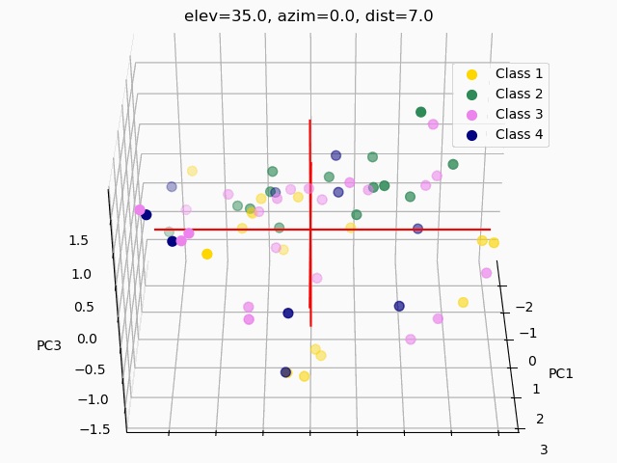
Reduces dimensions for easier visualization and interpretation.
Applications of PCA
2. Exploratory Data Analysis (EDA):
Use Case: Visualize high-dimensional data in 2D or 3D.
Example: Clustering customer segments for marketing analysis.
How PCA Helps:
Reduces dimensions for easier visualization and interpretation.
Dataset: Iris Dataset

Slide 38
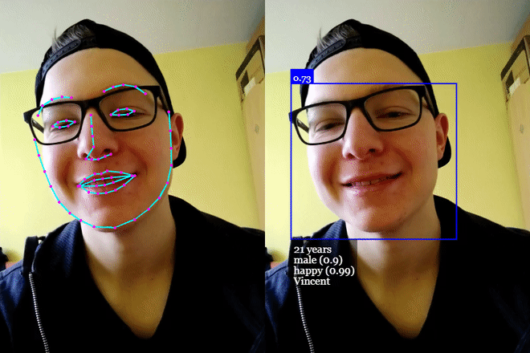
Reduces dimensions for easier visualization and interpretation.
Applications of PCA
3. Face Recognition:
Use Case: Reduce dimensions in image datasets.
Example: Eigenfaces for identifying individuals in images.
How PCA Helps:
Extracts principal components (features) for efficient comparison.
Dataset: Labelled Faces in the Wild Dataset

Slide 39
Reduces dimensions for easier visualization and interpretation.
Applications of PCA
4. Financial Analysis:
Use Case: Analyze stock price movements.
Example: Identifying the main factors influencing market trends.
How PCA Helps:
Reduces noise and identifies significant variables in financial data.
Dataset: Yahoo Finance Data Dataset

Slide 40
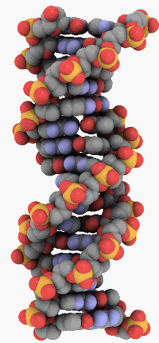
Reduces dimensions for easier visualization and interpretation.
Applications of PCA
5. Bioinformatics:
Use Case: Study protein structures or genetic variations.
Example: Classifying diseases based on gene expressions.
How PCA Helps:
Finds key genetic markers by reducing redundant features.
Dataset: TCGA Data Portal Dataset

Slide 41
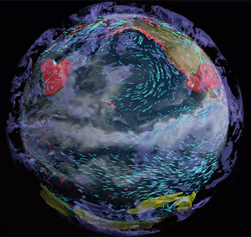
Reduces dimensions for easier visualization and interpretation.
Applications of PCA
6. Climate Science:
Use Case: Analyze global temperature trends.
Example: Identifying patterns in weather or climate datasets.
How PCA Helps:
Highlights dominant factors affecting climate variability.
Dataset: NOAA Climate Data Dataset

Slide 42
Difference Between SVD and PCA

Slide 43
Difference Between SVD and PCA
SVD and PCA are closely related in linear algebra and machine learning, but they have distinct roles and differences:
Nature of the Techniques
SVD: A general matrix factorization method that decomposes any rectangular matrix 𝐴 into three matrices:
PCA: A dimensionality reduction technique that transforms the data into a new coordinate system where the axes (principal components) correspond to directions of maximum variance.
PCA applies SVD on the co-variance matrix of the data to extract eigenvalues and eigenvectors, focusing on capturing variance.

Slide 44
Difference Between SVD and PCA
2. Input Data
SVD: Directly applied to the original data matrix 𝐴, regardless of its dimensions. Useful for tasks like matrix completion, dimensionality reduction, and noise filtering.
PCA: Requires a preprocessed co-variance or correlation matrix. Typically used for reducing dimensions in data with significant variance.

Slide 45
Difference Between SVD and PCA
3. Decomposition Components
SVD: Decomposes a matrix into singular vectors and singular values. Singular values (Σ) represent the importance of each component.
PCA: Finds eigenvalues and eigenvectors from the covariance matrix. Eigenvectors represent principal components, and eigenvalues indicate the variance explained by each component.

Slide 46
Difference Between SVD and PCA
4. Variance and Scaling
SVD: Does not directly focus on variance. Applied to non-statistical matrices (e.g., term-document matrices in NLP, image matrices).
PCA: Explicitly captures variance in the given data. Requires the data to be standardized or scaled to ensure components are comparable.

Slide 47
Difference Between SVD and PCA
5. Application Focus
SVD: General-purpose matrix decomposition. Used in image compression, recommender systems, and latent semantic analysis in text.
PCA: Focused on dimensionality reduction and exploratory data analysis. Commonly used in feature reduction and visualization of high-dimensional datasets.

Slide 48
Difference Between SVD and PCA
6. Computational Complexity
SVD: Directly computes the decomposition of the full matrix, which can be computationally expensive for large datasets.
PCA: working on the covariance matrix (smaller than the data matrix in many cases), it is computationally less expensive than SVD for certain applications.

Slide 49
Difference Between SVD and PCA
7. Output Interpretability
SVD: Outputs singular values, which may not directly indicate variance. Singular vectors are orthogonal, but their interpretation depends on the application.
PCA: Outputs principal components, easily interpreted as new axes of maximum variance.

Slide 50


Slide 51




Not included in the Syllabus
The No.1 Productivity Expert: 10,000 Hours Is A Lie! This Morning Habit Is Ruining Your Day!
URL: The No.1 Productivity Expert: 10,000 Hours Is A Lie! This Morning Habit Is Ruining Your Day!
Duration: 02:06:24

